Slide 1
7FNCE040W
Business Analytics
WEEK 7 (Bite 2)

Slide 2
Unstructured Data Analytic Techniques Cluster Analysis.

Slide 3
Wk 7 Bite 2
Lets continue with an example. Open file
‘’Attitude towards Shopping.sav’’

Slide 4
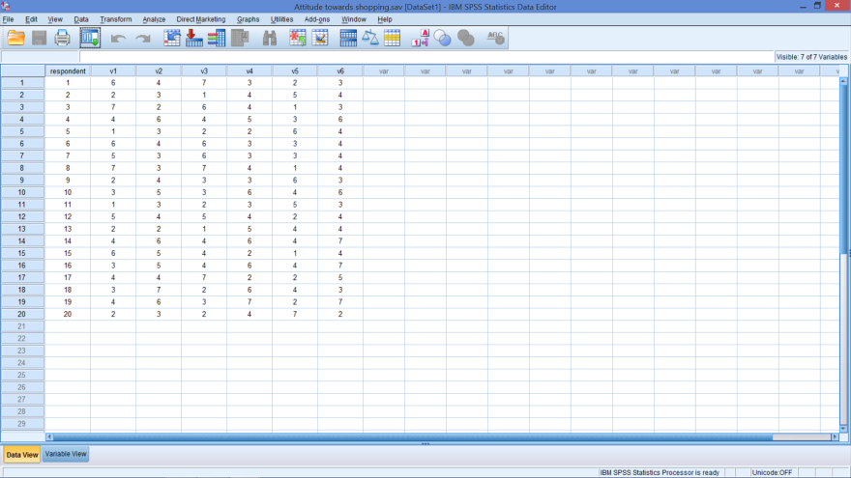
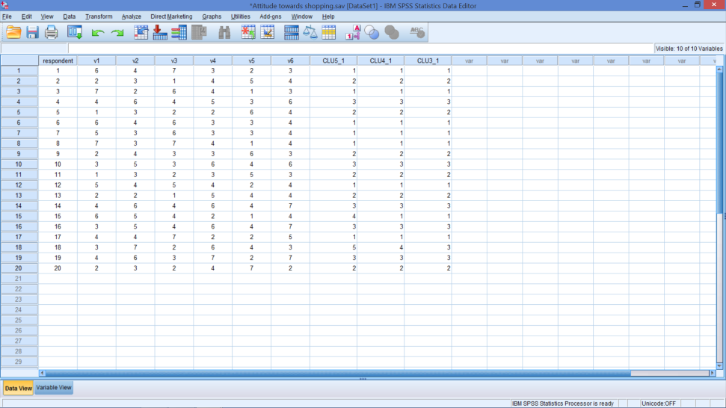
Attitudes towards Shopping
Beginning Data
Ending Data
Notes:
3 new columns of data
These correspond to the cluster membership table just shown
The _1 in the column heading (variable name) indicates the 1st time the analyses ran

Slide 5
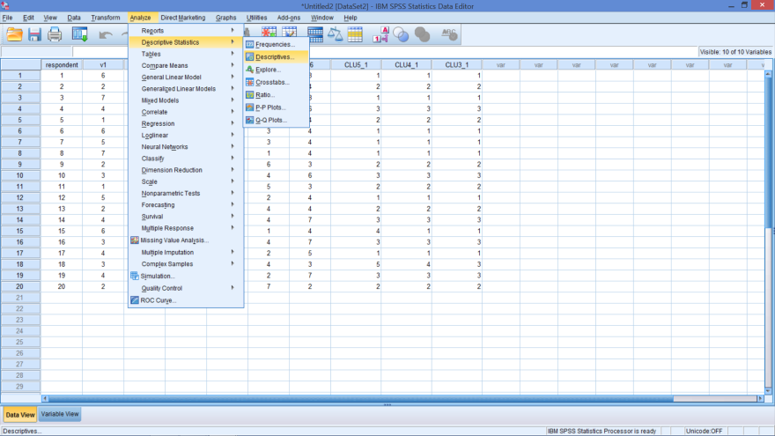
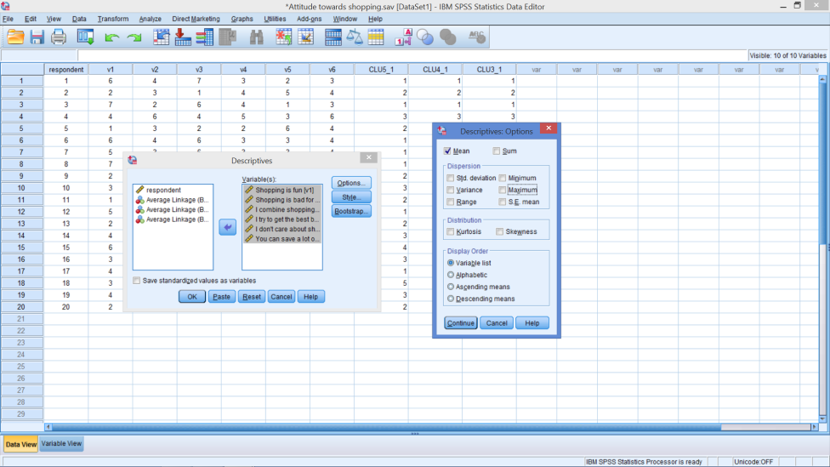
Get Overall Means
Notes:
Analyze → Descriptive Statistics → Descriptives…
Variables: V1 – V6
In Options box: Just tick mean (untick others)

Slide 6
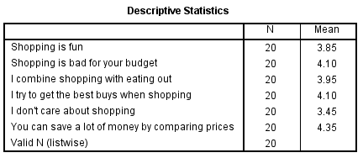
Overall Means

Slide 7
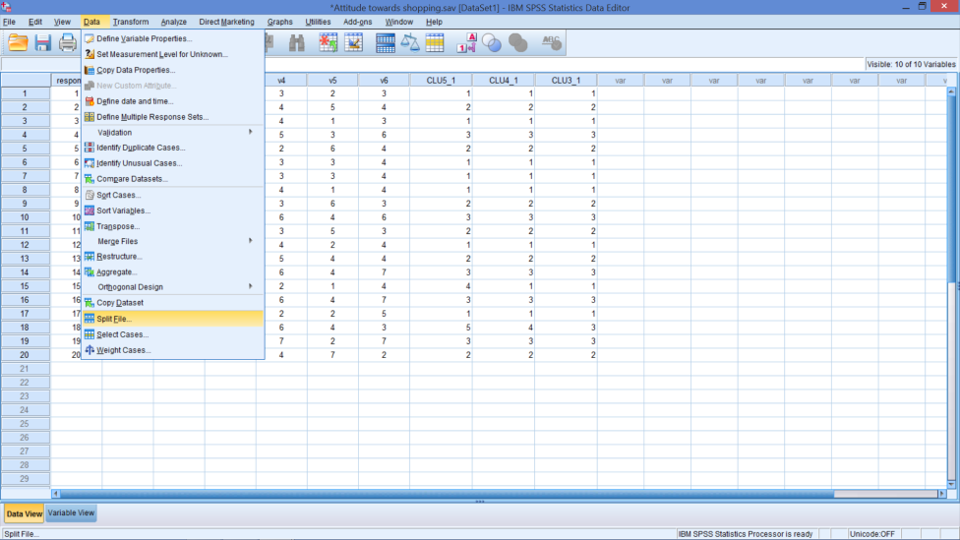
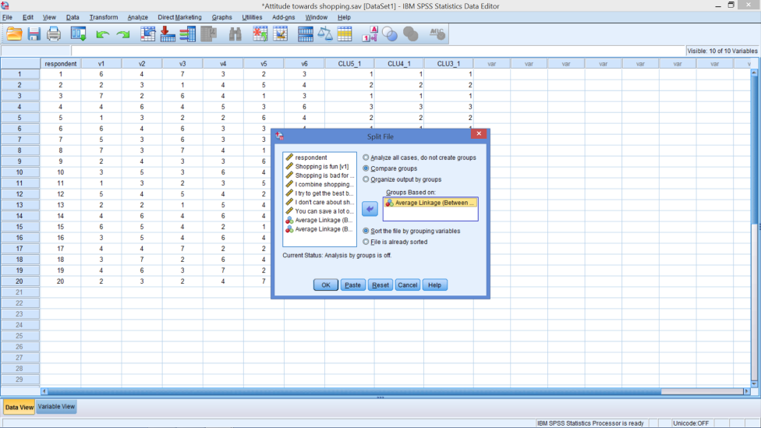
To Get Cluster Means - Split File On
Cluster Membership with 3 segments (clusters)
Notes:
Data → Split File
Tick: Compare Groups
Insert Cluster Membership with 3 Segments (Probably last row)

Slide 8
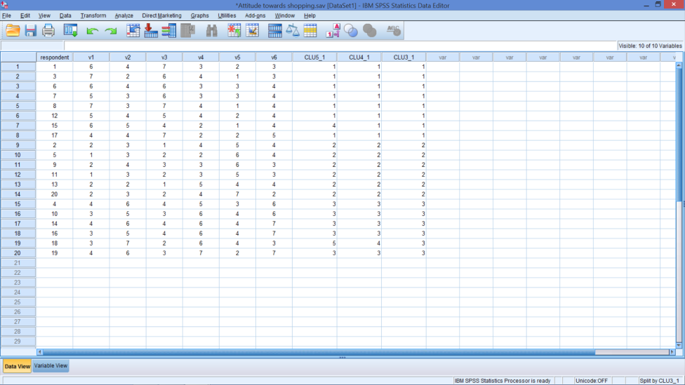
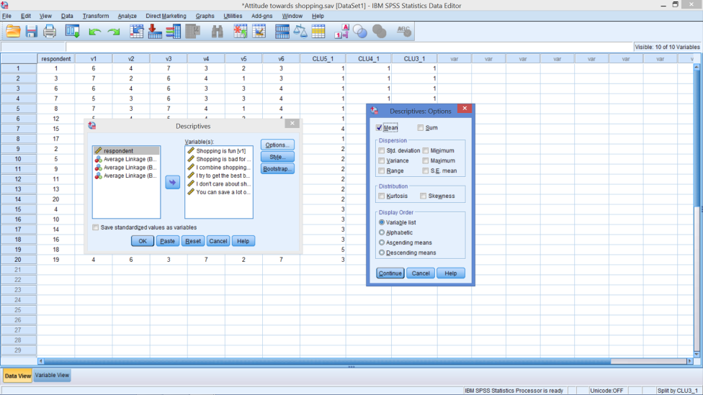
Get Means By Cluster

Slide 9
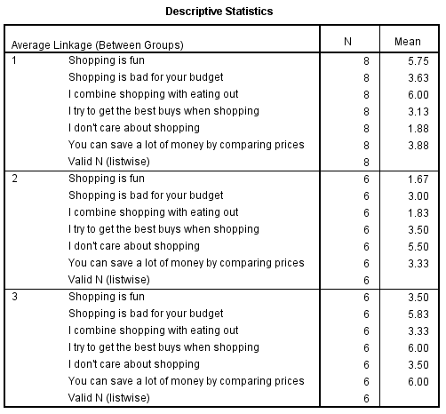
Output Table

Slide 10
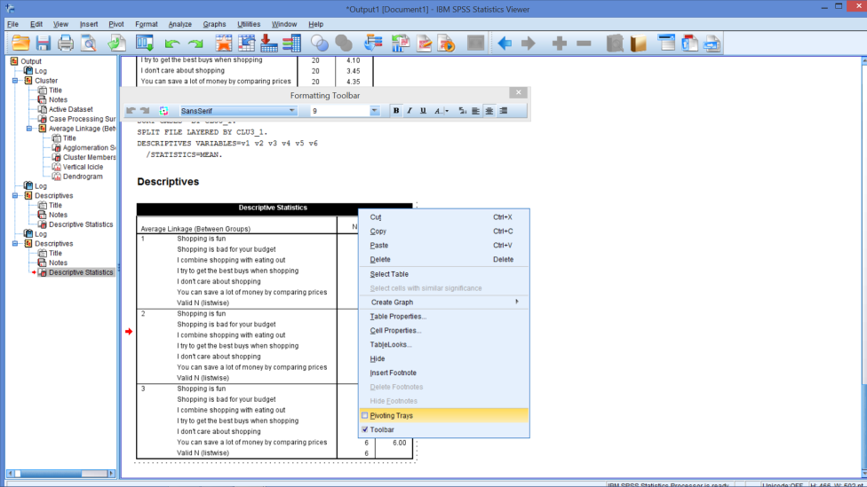
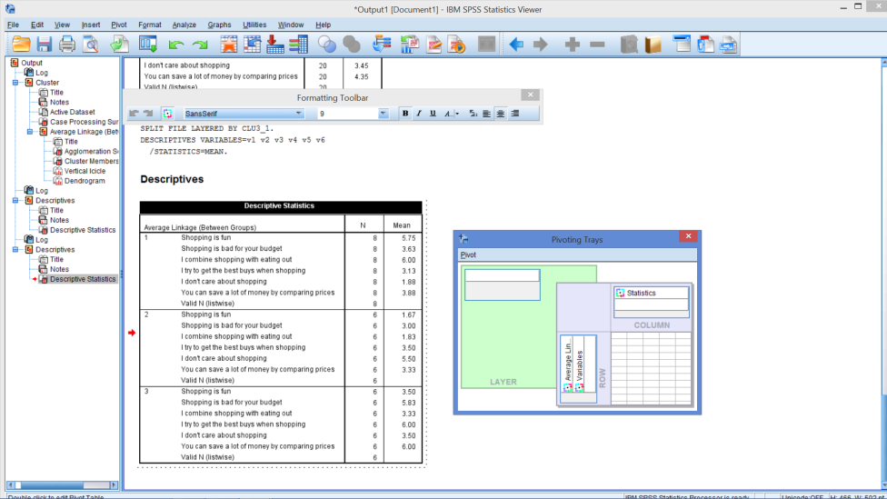
Open Pivot Trays
Notes:
There are many edits you can do once you double click on the table such as resetting columns widths, which I often do so the tables fits on the slides better.
Double click on table
See broken border
Right click
Select pivot trays

Slide 11
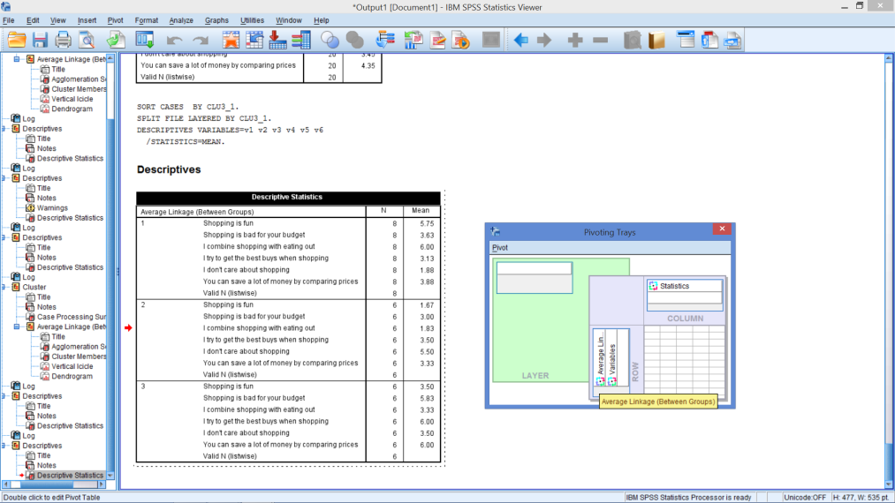
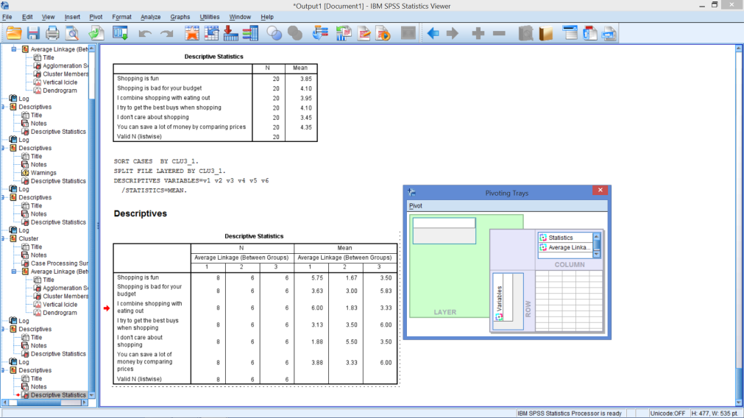
Move Cluster Membership to a Column
Notes:
Click on the colorful circle next to ‘Average Linkage’
Drag and drop it under ‘Statistics’

Slide 12
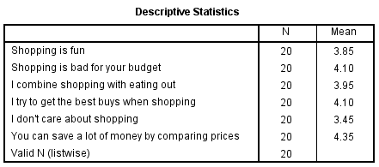
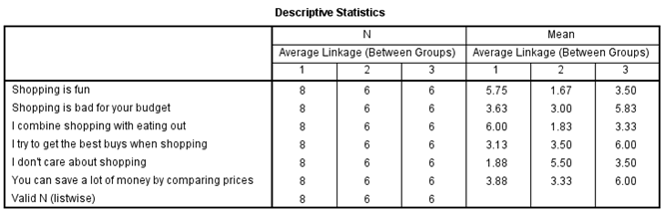
Overall Means

Slide 13

Are the clusters different?
Notes:
Step 1: Look across each row
Which segment has the highest value for each attribute?
Which segment has the lowest value for each attribute?
Which segments have means very similar to group average?
Which segments have means very different from the group average?
Step 2: Look down each column
What is similar about members in each segment?
What distinguishes one segment from another?
Name each segment
Interpretation involves examining the distinguishing characteristics of each cluster’s profile and identifying substantial differences between clusters
Cluster solutions failing to show substantial variation indicate other cluster solutions should be examined
If the clusters don’t appear different, then look at 2 or 4 clusters.

Slide 14
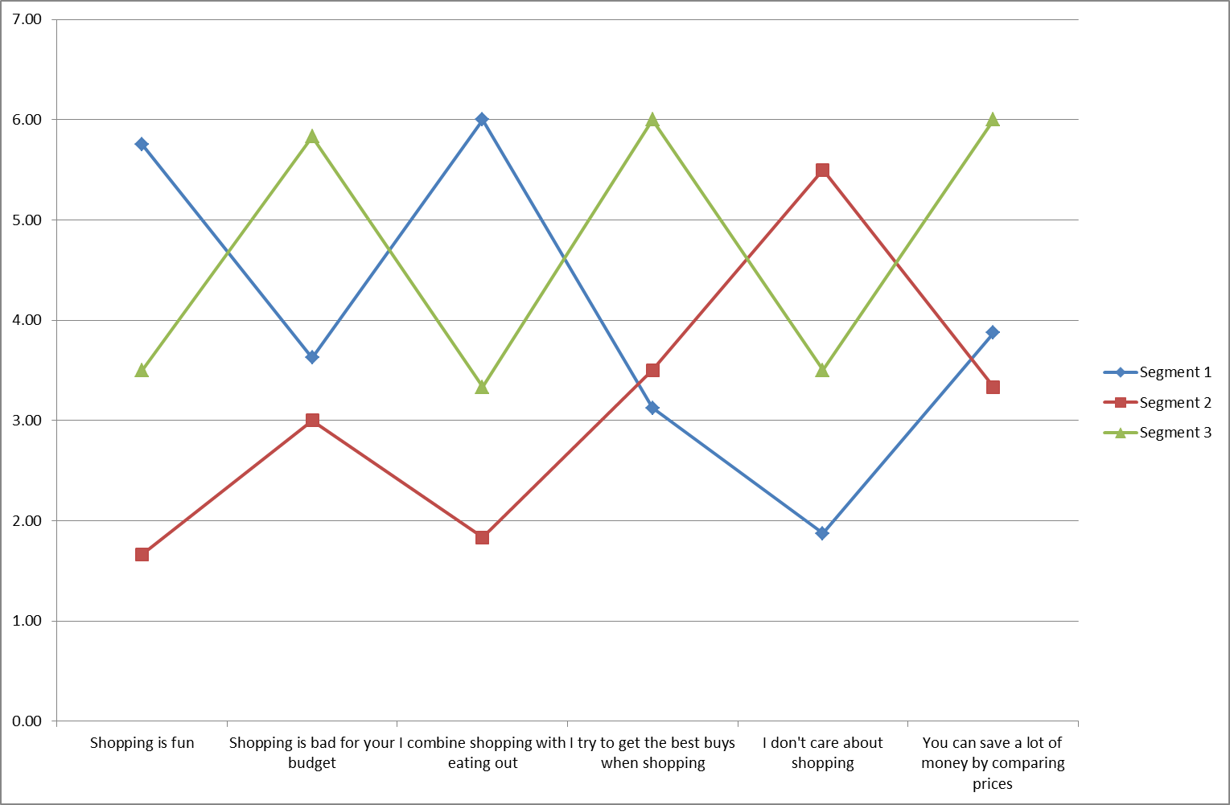
Visually See How Segments Differ
Notes:
This line chart is also called a snake plot.

Slide 15
Create 2 More Means Tables
4 Clusters
5 Clusters
Change Split File
4 Clusters
Rerun Means
Pivot the table
Change Split File
5 Clusters
Rerun Means
Pivot the table

Slide 16
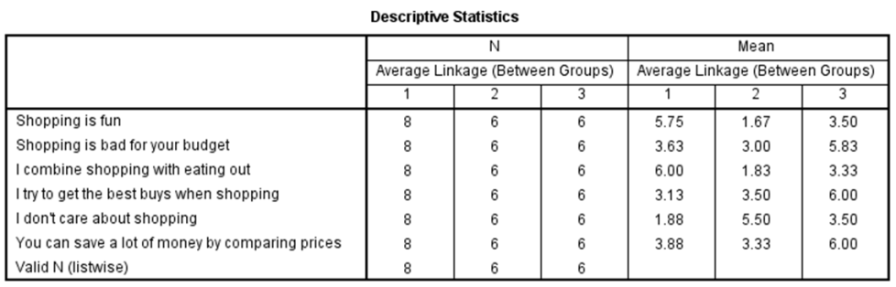
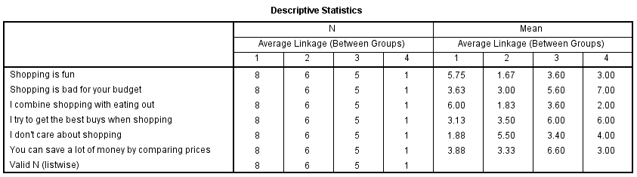
Comparing Means Tables
Notes:
Single-member or extremely small clusters are generally not acceptable and should generally be eliminated.

Slide 17
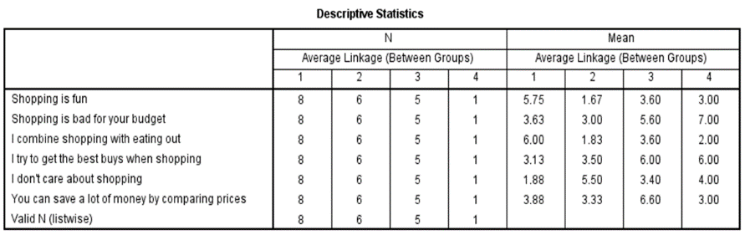
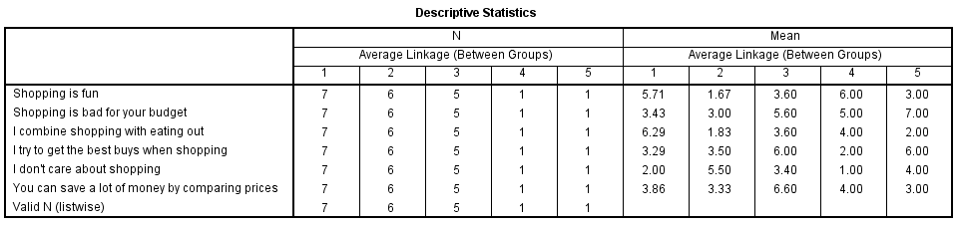
Compare 4 to 5 – if necessary

Slide 18
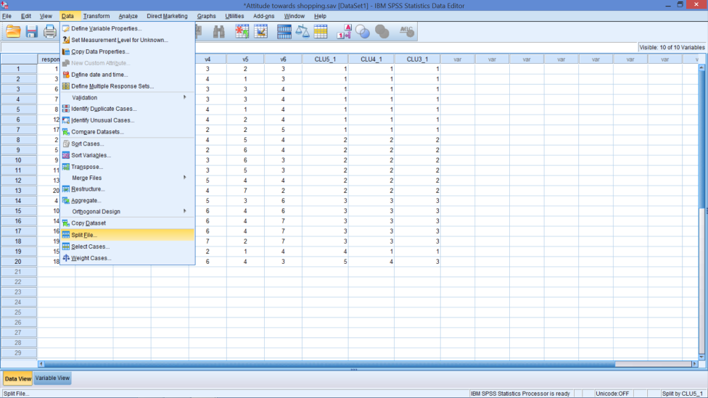
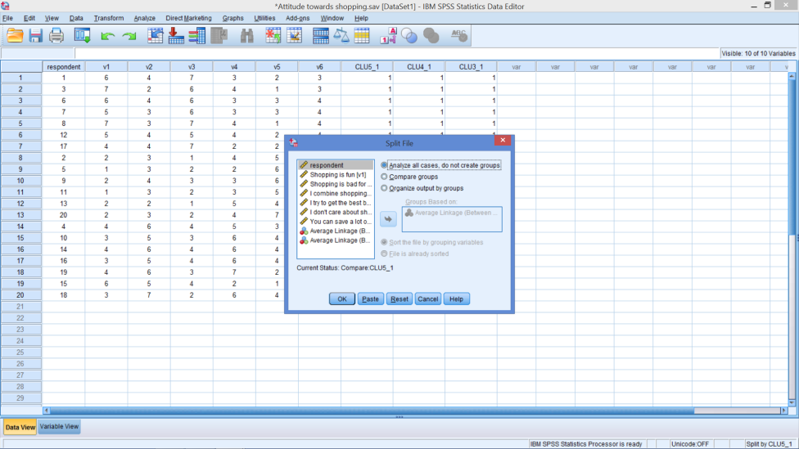
To Turn Off Split File

Slide 19
Conducting Cluster Analysis
1
2
3
6
4
5
Formulate the problem
Select a distance measure
Select a clustering procedure
Decide on the number of clusters
Interpret and profile the clusters
Assess the validity of the clustering
Notes:
Interpreting and profiling clusters involves examining the cluster means (centroids). The centroids enable us to describe each cluster by assigning it a name or label.
It is often helpful to profile the clusters in terms of variables that were not used for clustering (using discriminant analysis). These may include demographic, psychographic, product usage, media usage, or other variables.

Slide 20
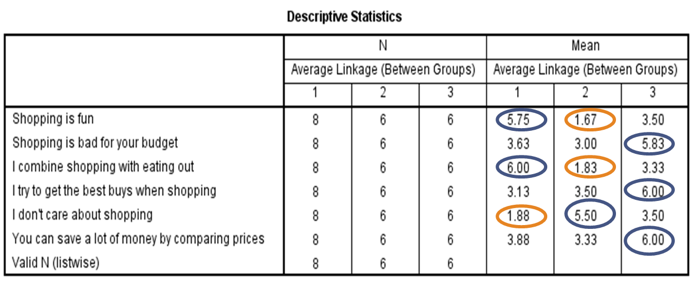
Can you name each cluster?
Notes:
Interpreting and profiling clusters involves examining the cluster centroids (means). The centroids enable us to describe each cluster by assigning it a name or label.
Cluster solutions ultimately must have theoretical validity assess through external validation.
Finally, create names for each segment
Cluster 1:
Cluster 2:
Cluster 3:

Slide 21
Conducting Cluster Analysis
1
2
3
6
4
5
Formulate the problem
Select a distance measure
Select a clustering procedure
Decide on the number of clusters
Interpret and profile the clusters
Assess the validity of the clustering
Notes:
Here are some methods of validating the cluster solution:
Perform cluster analysis on the same data using different distance measures. Compare the results across measures to determine the stability of the solutions.
Use different methods of clustering and compare the results.
Split the data randomly into halves. Perform clustering separately on each half. Compare cluster centroids across the two subsamples.
Delete variables randomly. Perform clustering based on the reduced set of variables. Compare the results with those obtained by clustering based on the entire set of variables.
In nonhierarchical clustering, the solution may depend on the order of cases in the data set. Make multiple runs using different order of cases until the solution stabilizes.

Slide 22
Partitioning Method: K-means
Cluster center
Predetermined # of segments
Move centers & borders
Minimize a
a = distance from respondent to cluster center
Maximize b
b = distance between centers
= distance from I to III
= distance from I to II
= distance from II to III
Cluster border
•
•
III
•
•
Dimension 2
•
b
b
I
•
•
b
•
•
a
•
•
•
II
Dimension 1
One respondent
Notes:
36
36

Slide 23
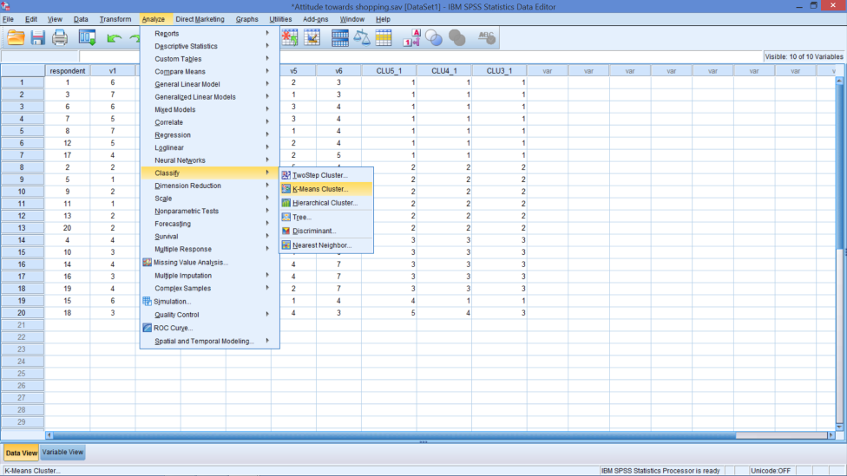
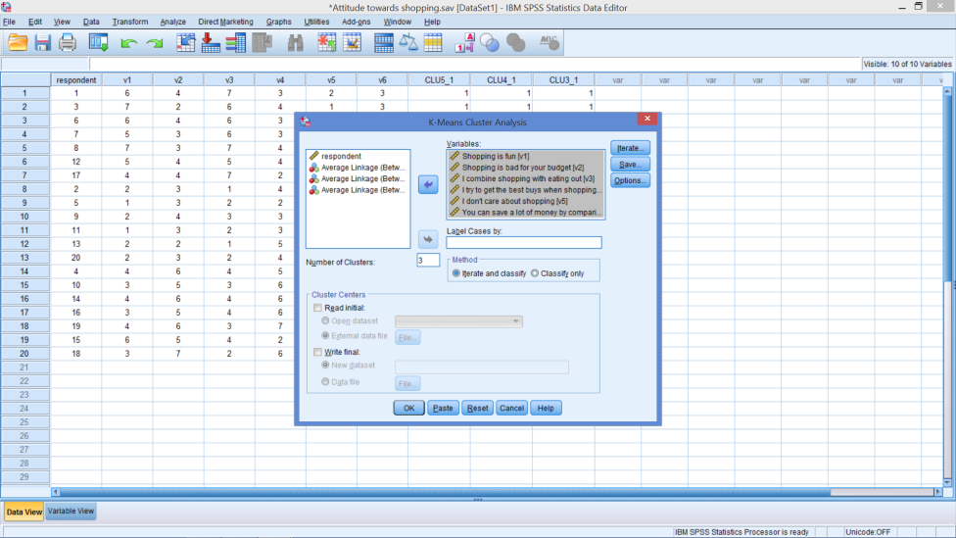
K-means Clustering
Notes:
Be sure split file is off
Data → Split File
Tick: Analyze all cases, do not create groups
Analyze → Classify → K-means Cluster…
Move V1 – V6 to variables box
For Number of Clusters: Insert number from hierarchical clustering decision (3)

Slide 24
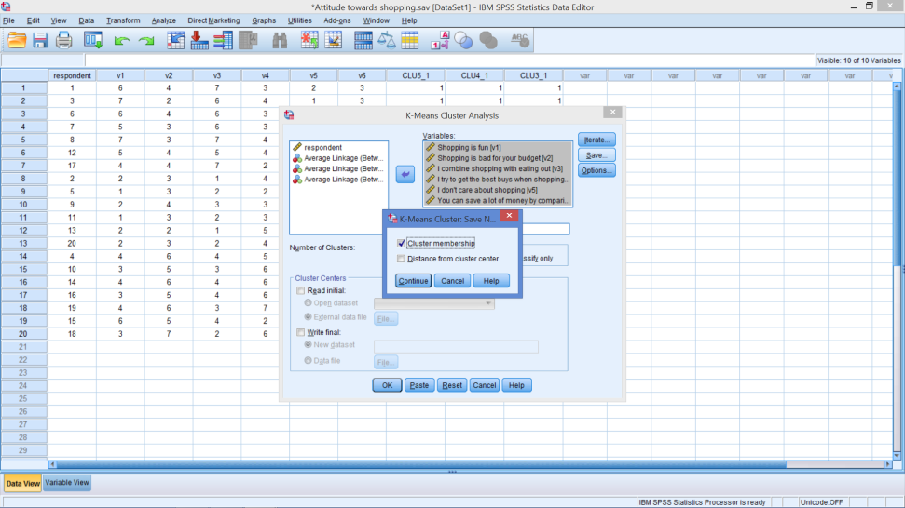
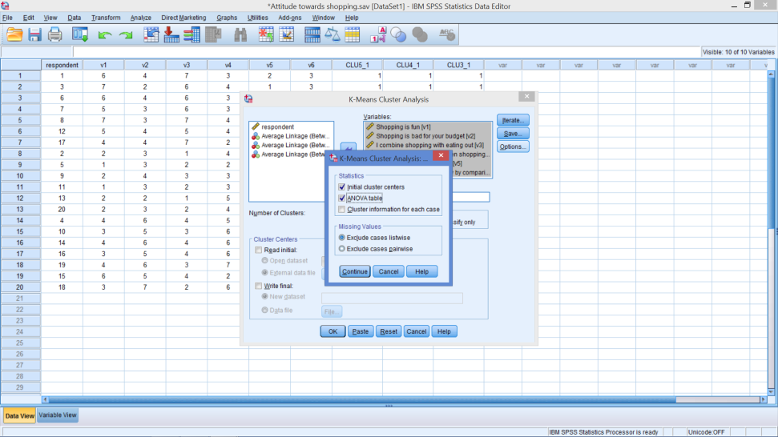
K-means Clustering
Save Box
Options Box
Notes:
Save Box: Tick Cluster membership
Options Box: Tick ANOVA table

Slide 25
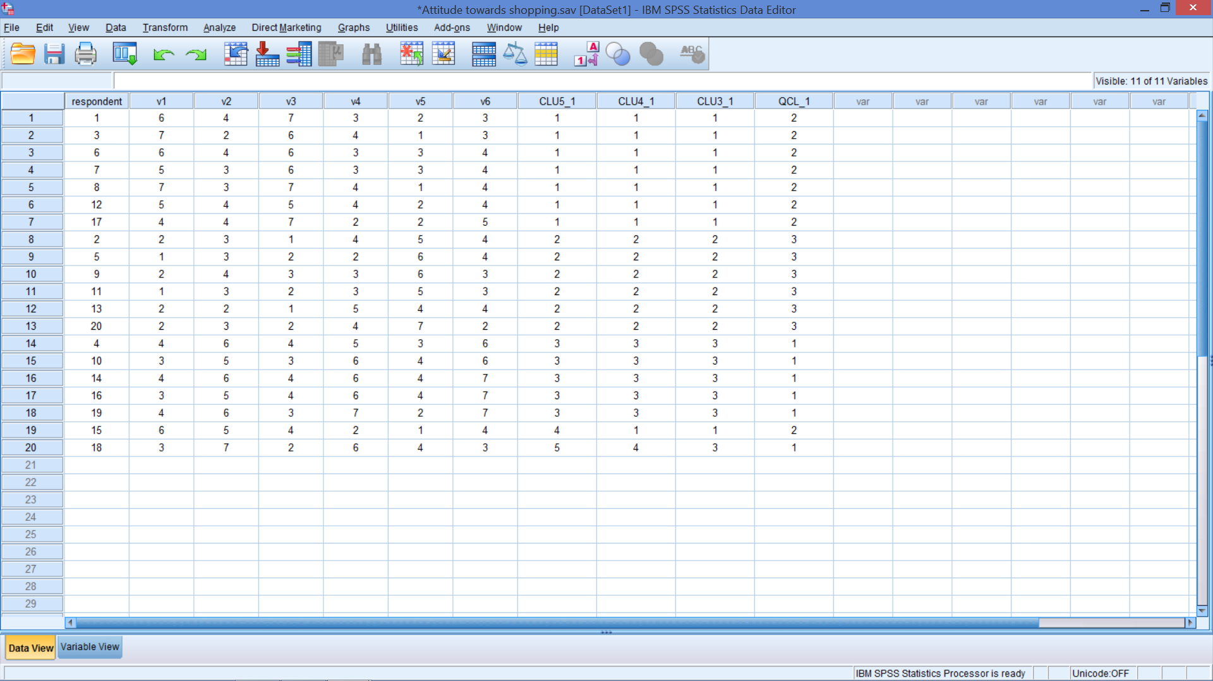
K-means Clustering

Slide 26
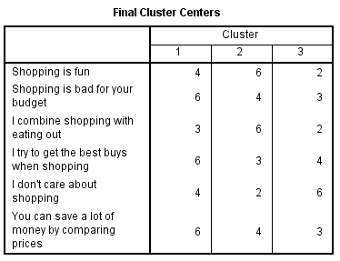
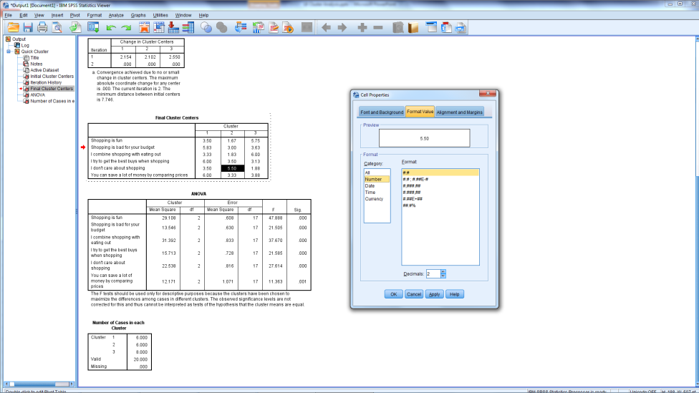
To Show More Decimal Places
Notes:
Tables may not show 2 decimal places.
If you want more places to show:
Double click on table
Find Cell Properties
Find Format Values
Click on Number
Set Decimal places to 2

Slide 27
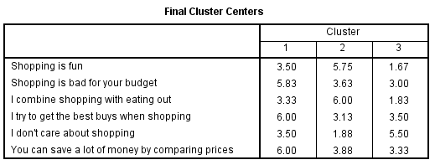
Final Clusters
Notes:
Tables may not show 2 decimal places.
If you want more places to show:
Double click on table
Find Cell Properties
Find Format Values
Click on Number
Set Decimal places to 2

Slide 28
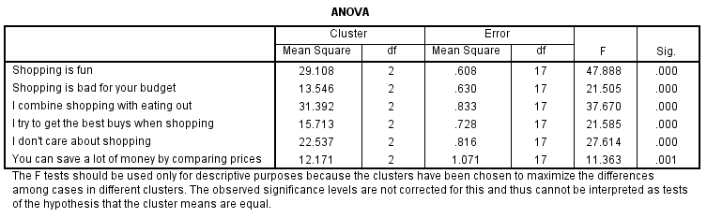
What can you infer from this table?
Notes:
The ANOVA compares the means within each segment for each variable.
What does it mean when Sig. is < 0.05?

Slide 29
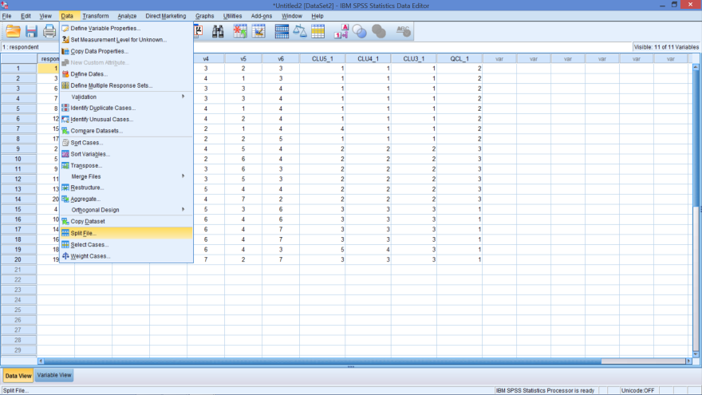
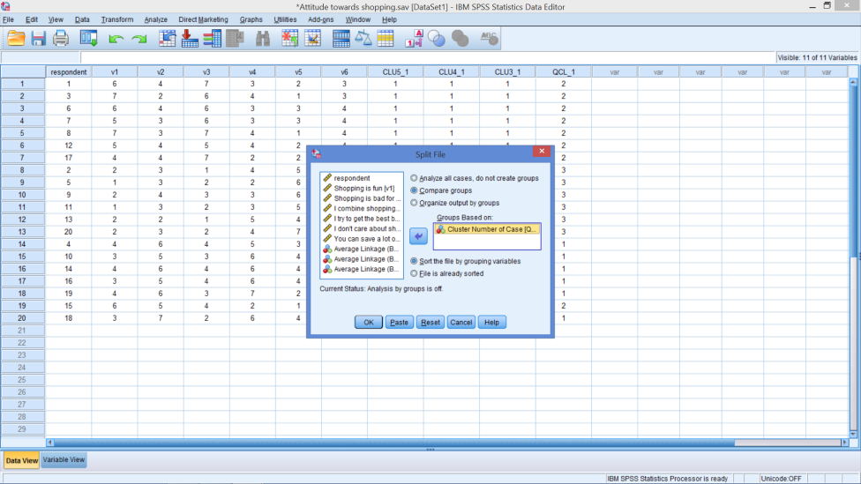
K-Means: Turn On Split File

Slide 30
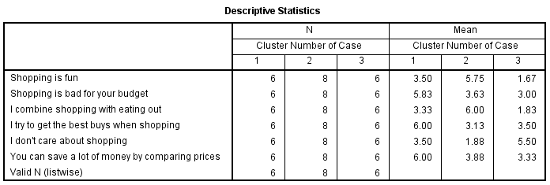
Overall Means

Slide 31
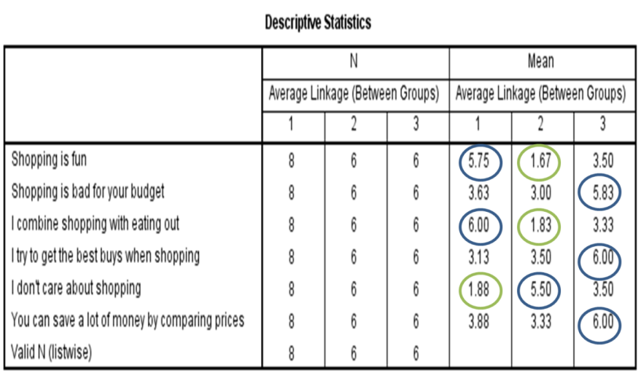
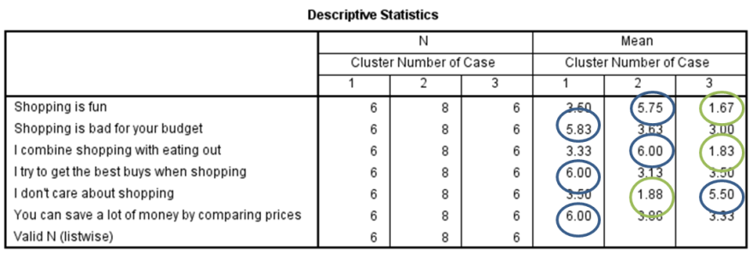
Compare Clustering Output
Average Linkage
K-means

Slide 32
Cluster Analysis …
is descriptive
is totally dependent upon the variables used
will always create clusters
Notes:
Cluster analysis is descriptive, a theoretical, and non inferential
Will always create clusters, regardless of the actual existence of any structure in the data.
The cluster solution is not generalizable because it is totally dependent upon the variables used as the basis for the similarity measure.

Slide 33

In-class Exercises try the questions in the pdf file using data sets; 1) Nike.sav 2)Outdoor.sav

Slide 34
Assessments
Following Week – Class time
Group Assessment
Teams set Get teams sorted 3 or 4 students ?
Next Week – Hopefully
Figure out which questions to answer?
Future Work time

